Slide 1
Federated analytics
Principles and shared language
Notes:
Session 1. General principles and shared language. Duration: 45 minutes. Suggested timing: slides 1–7 foundations 10 minutes, slides 8–24 taxonomy and its applications 20 minutes, slides 25–27 privacy and consequences 6 minutes, slides 28–31 techniques, research issues and closing discussion 9 minutes. Reference slide 32 remains available. Taxonomy transition slides take around 15 seconds each. Use discussion prompts selectively. Session 2 introduces the clinical characterisation scenario.
Sources:
Wang, Z., Ji, H., Zhu, Y., Wang, D. and Han, Z. A Survey on Federated Analytics: Taxonomy, Enabling Techniques, Applications and Open Issues. IEEE Communications Surveys & Tutorials 28 (2026), 2457–2496. Online 10 April 2025. DOI: 10.1109/COMST.2025.3558755.

Slide 2
Motivation for federated analytics
Useful data sit across devices and organisations
Moving raw records can create privacy and transfer costs
Local computation supports analysis across data holders
Notes:
Teaching notes:
The survey motivates federation through growing edge data, communication demands and concerns about disclosure. Benefits depend on the task: compact summaries can reduce transfer, but repeated rounds and cryptography can increase workload. Avoid assuming that federation is always cheaper or that every output is safe.
Discussion prompt (choose according to time):
When might moving a computation be easier than moving the underlying data?
Survey source: I.
Sources:
Wang et al. A Survey on Federated Analytics: Taxonomy, Enabling Techniques, Applications and Open Issues. IEEE Communications Surveys & Tutorials, 28 (2026), 2457–2496. Published online 2025. DOI: 10.1109/COMST.2025.3558755. Local source: Reference papers/a survey on federated analytics.pdf.

Slide 3
Definition and shared vocabulary
Term | Meaning
Federated analytics (FA) | Collaborative analysis with raw data kept locally
Client / data owner | Participant holding the local dataset
Insight | Task-specific output of local computation
Aggregation | Computation combining the local insights
Notes:
Teaching notes:
The survey uses insight for an intermediate result. It can be a count, a compact encoding, a centroid or another structure. It is not a general label for a conclusion. Clients may be devices or institutions. A server often coordinates them, although other coordination models exist.
Discussion prompt (choose according to time):
What could an insight contain for a task that counts the use of an application feature?
Survey source: III-A and III-B.
Sources:
Wang et al. A Survey on Federated Analytics: Taxonomy, Enabling Techniques, Applications and Open Issues. IEEE Communications Surveys & Tutorials, 28 (2026), 2457–2496. Published online 2025. DOI: 10.1109/COMST.2025.3558755. Local source: Reference papers/a survey on federated analytics.pdf.

Slide 4
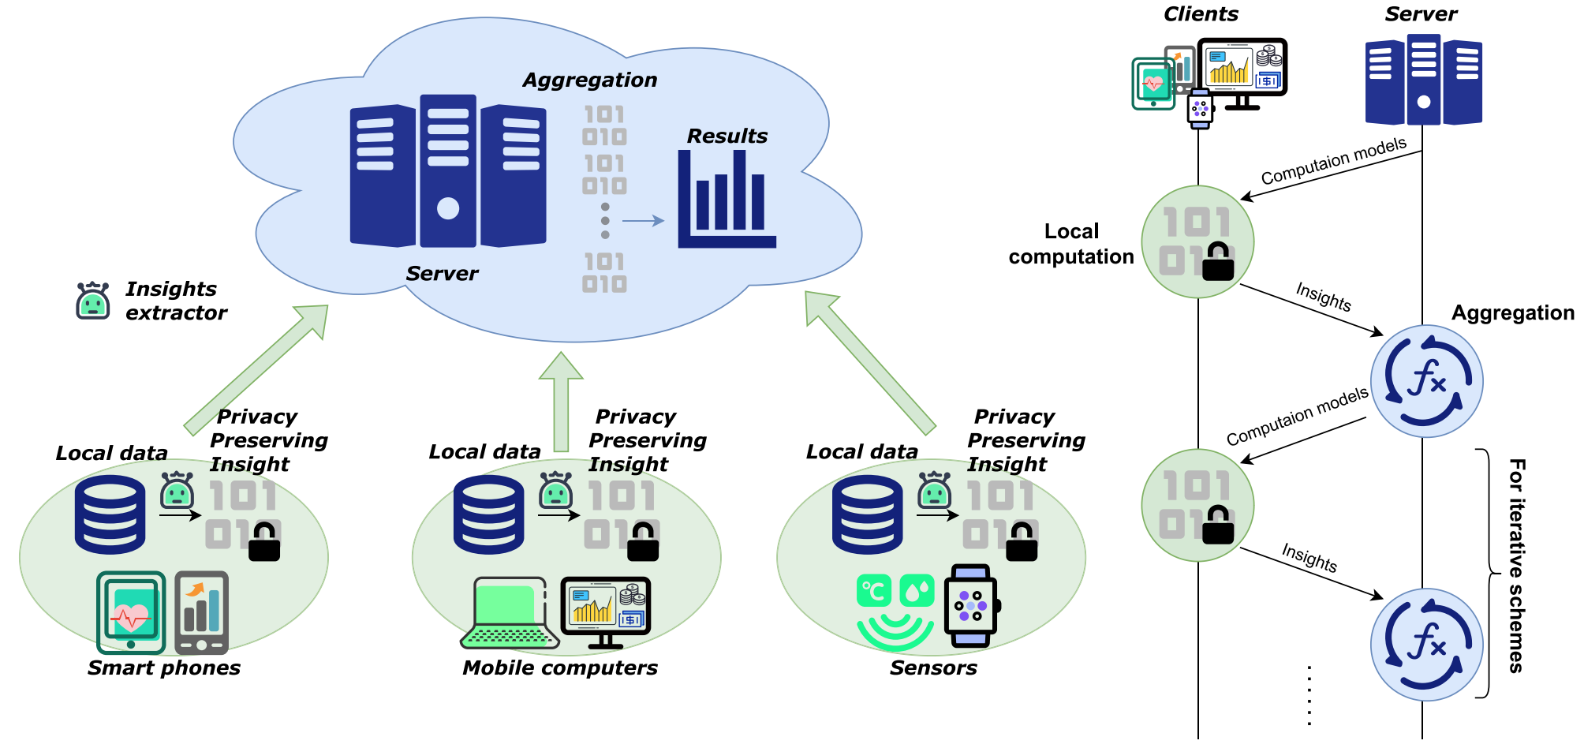
Federated analytics workflow
Wang et al. (2025), Figure 2.
Notes:
Teaching notes:
The original figure shows local insight extraction and server aggregation on the left. The right-hand side shows repeated computation-model distribution, local computation, insight upload and aggregation. One-shot tasks complete after one round. The locks represent privacy mechanisms in the design, which need explicit assumptions.
Discussion prompt (choose according to time):
Which parts happen at the client and which at the server?
Survey source: III-A, Figure 2.
Sources:
Wang et al. A Survey on Federated Analytics: Taxonomy, Enabling Techniques, Applications and Open Issues. IEEE Communications Surveys & Tutorials, 28 (2026), 2457–2496. Published online 2025. DOI: 10.1109/COMST.2025.3558755. Local source: Reference papers/a survey on federated analytics.pdf.

Slide 5
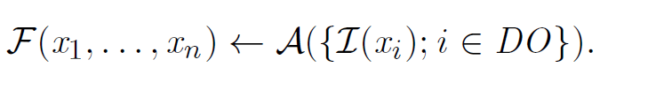
The analytical task and its computation
Task function F: the overall result we want
xi: Local client data
DO: Data owners
Insight function I: what each client calculates
Aggregation function A: how insights produce the result
Notes:
Teaching notes:
Section III-B formulates the target as F(x1,…,xn) and the federated result as A({I(xi)}). The design question is whether these match, or how close the approximation is. Different clients can sometimes use different insight functions. In iterative designs, earlier aggregated results change later local computations. This slide uses verbal definitions to avoid requiring mathematical notation.
Discussion prompt (choose according to time):
Could the same local output support both a mean and a median?
Survey source: III-B.
Sources:
Wang et al. A Survey on Federated Analytics: Taxonomy, Enabling Techniques, Applications and Open Issues. IEEE Communications Surveys & Tutorials, 28 (2026), 2457–2496. Published online 2025. DOI: 10.1109/COMST.2025.3558755. Local source: Reference papers/a survey on federated analytics.pdf.

Slide 6
Exact and approximate results
The researchers need to design insight derivation function I and
aggregation function A so that the FA result
should be identical (or close to) the result of the task
Notes:
Teaching notes:
Section III-B formulates the target as F(x1,…,xn) and the federated result as A({I(xi)}). The design question is whether these match, or how close the approximation is. Different clients can sometimes use different insight functions. In iterative designs, earlier aggregated results change later local computations. This slide uses verbal definitions to avoid requiring mathematical notation.
Discussion prompt (choose according to time):
Could the same local output support both a mean and a median?
Survey source: III-B.
Sources:
Wang et al. A Survey on Federated Analytics: Taxonomy, Enabling Techniques, Applications and Open Issues. IEEE Communications Surveys & Tutorials, 28 (2026), 2457–2496. Published online 2025. DOI: 10.1109/COMST.2025.3558755. Local source: Reference papers/a survey on federated analytics.pdf.
The objective is to design I and A to reproduce the task result exactly or with an acceptable approximation. Counts and means can be exact under suitable assumptions. Sketching, sampling or differential privacy can introduce error. Distinguish the error introduced by the protocol from the usual statistical uncertainty. Discussion: Which tasks require exact results, and where would an approximation be acceptable?

Slide 7
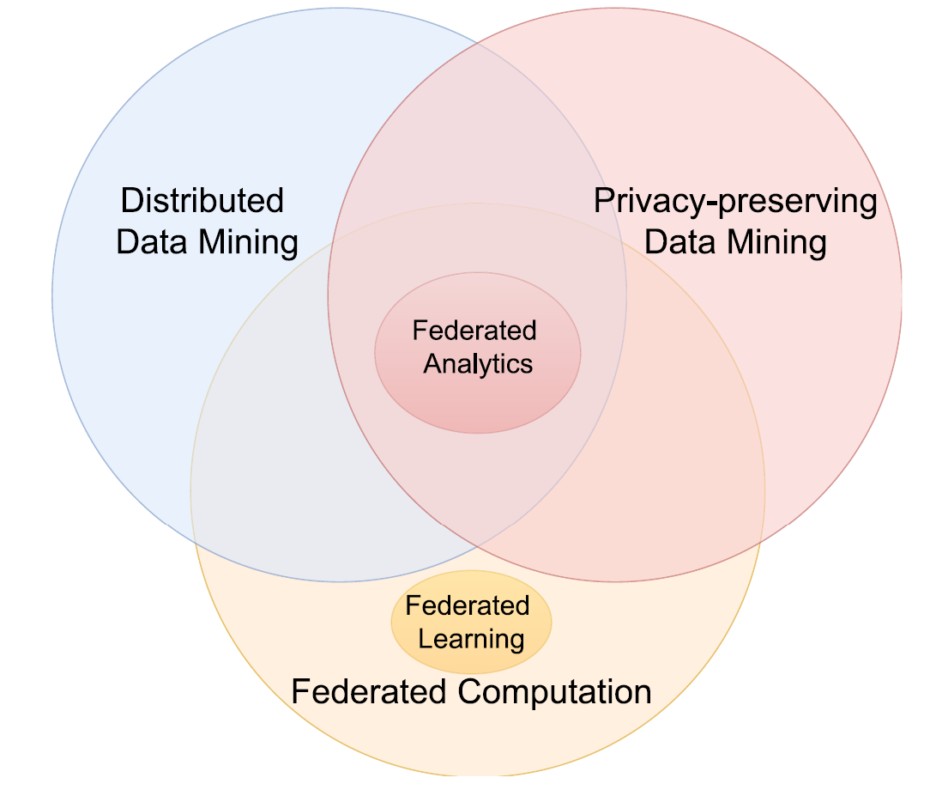
Related fields
Distributed data mining: analyses data across multiple locations.
Privacy-preserving data mining: protects sensitive information during analysis.
Federated computation: keeps raw data local and shares computational outputs.
Federated analytics: combines these approaches for descriptive and exploratory analysis.
Federated learning: uses federated computation to train predictive models.
Wang et al. (2025), Figure 3.
Notes:
Teaching notes:
The survey positions FA within distributed and privacy-preserving data mining. Distributed processing can occur inside a trusted system and may permit movement of raw data. Privacy-preserving analysis can also occur on a central dataset. FA combines distributed ownership with local retention of raw data and privacy mechanisms. The term may be recent while some relevant techniques predate it.
Discussion prompt (choose according to time):
What additional assumptions arise when separate owners control the data?
Survey source: II and III-C2–C3.
Sources:
Wang et al. A Survey on Federated Analytics: Taxonomy, Enabling Techniques, Applications and Open Issues. IEEE Communications Surveys & Tutorials, 28 (2026), 2457–2496. Published online 2025. DOI: 10.1109/COMST.2025.3558755. Local source: Reference papers/a survey on federated analytics.pdf.

Slide 8
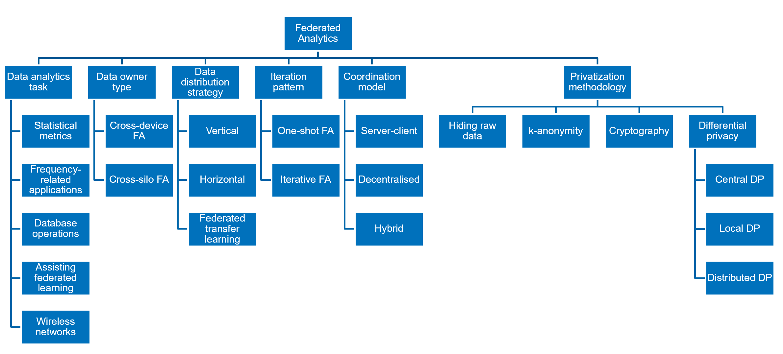
Federated analytics dimensions
Notes:
Section transition. Briefly locate the highlighted topic within the taxonomy. The survey has five dimensions. Data distribution strategy is the workshop extension based on Zhu et al. Spend around 15 seconds on this roadmap.
Sources:
Wang, Z., Ji, H., Zhu, Y., Wang, D. and Han, Z. A Survey on Federated Analytics: Taxonomy, Enabling Techniques, Applications and Open Issues. IEEE Communications Surveys & Tutorials 28 (2026), 2457–2496. Online 10 April 2025. DOI: 10.1109/COMST.2025.3558755.
Zhu, S. Y., Tang, W., Xie, Y. T. and Xie, L. Z. A comprehensive review of federated learning for multi-center medical data. Biomedical Engineering Communications 4(2) (2025):9. DOI: 10.53388/BMEC2025009. CC BY 4.0.

Slide 9
Data analysis task
Notes:
Section transition. Briefly locate the highlighted topic within the taxonomy. The survey has five dimensions. Data distribution strategy is the workshop extension based on Zhu et al. Spend around 15 seconds on this roadmap.
Sources:
Wang, Z., Ji, H., Zhu, Y., Wang, D. and Han, Z. A Survey on Federated Analytics: Taxonomy, Enabling Techniques, Applications and Open Issues. IEEE Communications Surveys & Tutorials 28 (2026), 2457–2496. Online 10 April 2025. DOI: 10.1109/COMST.2025.3558755.
Zhu, S. Y., Tang, W., Xie, Y. T. and Xie, L. Z. A comprehensive review of federated learning for multi-center medical data. Biomedical Engineering Communications 4(2) (2025):9. DOI: 10.53388/BMEC2025009. CC BY 4.0.

Slide 10
Data analysis task
Data analytics task | Examples
Statistical metrics | Calculate means, percentiles, clusters and graph metrics.
Frequency-related applications | Estimate frequencies and identify common items or patterns.
Database operations | Execute queries across distributed databases.
Assisting federated learning | Support client selection, personalisation and model evaluation.
Wireless network applications | Support network analysis, planning and optimisation.

Slide 11
Statistical metrics
Task | Federated design consideration
Means | Combine compatible counts and sums
Medians and percentiles | Need information about the global ordering
Clustering | Combine or refine cluster information
Graph metrics | Protect relationships as well as values
Notes:
Teaching notes:
These are the four application subsections in Section VI. An exact mean can use the sum of local sums divided by the sum of local counts before privacy perturbation. Averaging local medians does not generally recover the global median; the survey reviews dedicated percentile protocols. Clustering can involve local centres and iteration. Graph analysis needs a clear model of where nodes and edges are held and what relationships the protocol reveals.
Discussion prompt (choose according to time):
Which of these results can be reconstructed from a few additive summaries?
Survey source: VI-A–VI-D.
Sources:
Wang et al. A Survey on Federated Analytics: Taxonomy, Enabling Techniques, Applications and Open Issues. IEEE Communications Surveys & Tutorials, 28 (2026), 2457–2496. Published online 2025. DOI: 10.1109/COMST.2025.3558755. Local source: Reference papers/a survey on federated analytics.pdf.

Slide 12
Frequency-related applications
Task | Question
Frequency oracle | How frequent is a queried item?
Heavy hitters | Which items occur most often?
Frequent pattern mining | Which items, sets or sequences are common?
Notes:
Teaching notes:
A frequency oracle is a representation that supports subsequent frequency estimates. Heavy hitters identify common items; frequent pattern mining can find all items above a threshold or the top k. Complexity grows with the data domain: a small known category list differs from arbitrary strings or long sequences. The survey reviews LDP, threshold, tree and cryptographic approaches. User counts and occurrence counts should be distinguished when defining a real task.
Discussion prompt (choose according to time):
What changes when the possible answers are unknown in advance?
Survey source: VII.
Sources:
Wang et al. A Survey on Federated Analytics: Taxonomy, Enabling Techniques, Applications and Open Issues. IEEE Communications Surveys & Tutorials, 28 (2026), 2457–2496. Published online 2025. DOI: 10.1109/COMST.2025.3558755. Local source: Reference papers/a survey on federated analytics.pdf.

Slide 13
Federated database operations
Express analysis as queries across local databases
A query plan splits local and joint operations
Cryptography can protect joint computation
Broader query support can increase execution costs
Notes:
Teaching notes:
Section VIII reviews SQL-based federation. Query planning can keep suitable work local and reserve secure computation for cross-party steps such as joins or comparisons. General query engines trade broad support against overhead, while specialised engines can optimise particular operations. SMCQL, Conclave, Senate, SAQE, Orchard and Arboretum are examples reviewed by the survey. Approximate query engines can use sampling and DP. A distributed SQL connection alone is not a privacy guarantee.
Discussion prompt (choose according to time):
Which query operations need information from more than one participant?
Survey source: VIII.
Sources:
Wang et al. A Survey on Federated Analytics: Taxonomy, Enabling Techniques, Applications and Open Issues. IEEE Communications Surveys & Tutorials, 28 (2026), 2457–2496. Published online 2025. DOI: 10.1109/COMST.2025.3558755. Local source: Reference papers/a survey on federated analytics.pdf.

Slide 14
Analytics supporting federated learning
Stage | FA contribution
Before or during training | Evaluate client data and guide selection
Personalisation | Cluster clients with similar characteristics
After training | Evaluate the model on distributed data
Notes:
Teaching notes:
Section IX separates client quality evaluation, client clustering for personalisation and model evaluation. Local losses, performance statistics or derived features can become insights. Selection may improve training speed or accuracy but can change representation and fairness. In evaluation, compatible counts and losses can be combined, but some metrics need richer information for an exact pooled result. Evaluation performs inference rather than fitting the model.
Discussion prompt (choose according to time):
Could selecting only clients that improve training performance give a misleading evaluation?
Survey source: IX-A–IX-C.
Sources:
Wang et al. A Survey on Federated Analytics: Taxonomy, Enabling Techniques, Applications and Open Issues. IEEE Communications Surveys & Tutorials, 28 (2026), 2457–2496. Published online 2025. DOI: 10.1109/COMST.2025.3558755. Local source: Reference papers/a survey on federated analytics.pdf.

Slide 15
Wireless network applications
Analytics can support network planning and optimisation
Examples include anomaly detection and task allocation
FA can also assist FL operating in wireless networks
Bandwidth, energy and channel conditions shape the design
Notes:
Teaching notes:
Section X separates wireless network model optimisation from assistance to wireless FL. Examples include clustering network signatures, mobile edge task allocation, content caching and combining predictions or labels. The survey reports that the wireless applications it reviewed mainly hide raw data rather than use advanced privacy guarantees. Wireless networks are an application area and a communication constraint. These examples describe the surveyed literature, not a claim about every current wireless system.
Discussion prompt (choose according to time):
How could changing connectivity affect both the result and the time needed to obtain it?
Survey source: X-A–X-B.
Sources:
Wang et al. A Survey on Federated Analytics: Taxonomy, Enabling Techniques, Applications and Open Issues. IEEE Communications Surveys & Tutorials, 28 (2026), 2457–2496. Published online 2025. DOI: 10.1109/COMST.2025.3558755. Local source: Reference papers/a survey on federated analytics.pdf.

Slide 16
Data owner type
Notes:
Section transition. Briefly locate the highlighted topic within the taxonomy. The survey has five dimensions. Data distribution strategy is the workshop extension based on Zhu et al. Spend around 15 seconds on this roadmap.
Sources:
Wang, Z., Ji, H., Zhu, Y., Wang, D. and Han, Z. A Survey on Federated Analytics: Taxonomy, Enabling Techniques, Applications and Open Issues. IEEE Communications Surveys & Tutorials 28 (2026), 2457–2496. Online 10 April 2025. DOI: 10.1109/COMST.2025.3558755.
Zhu, S. Y., Tang, W., Xie, Y. T. and Xie, L. Z. A comprehensive review of federated learning for multi-center medical data. Biomedical Engineering Communications 4(2) (2025):9. DOI: 10.53388/BMEC2025009. CC BY 4.0.

Slide 17
Data owner type
Cross-device | Cross-silo
Many phones, sensors or other devices | Fewer organisations with larger datasets
Limited local resources | Often stronger computing capacity
Participation can change frequently | Participation is often more stable
Scalability and lightweight tasks matter | Detailed computation may be feasible
Notes:
Teaching notes:
These are typical characteristics, not absolute rules. Device-scale systems must account for availability and communication limits. Organisations may have clear collaboration objectives, but can still differ in resources. The survey discusses differential privacy as common in large device systems and resource-intensive cryptography as more practical in smaller silo settings. Neither association is a requirement.
Discussion prompt (choose according to time):
How would a design change when moving from ten organisations to a million devices?
Survey source: III-D2.
Sources:
Wang et al. A Survey on Federated Analytics: Taxonomy, Enabling Techniques, Applications and Open Issues. IEEE Communications Surveys & Tutorials, 28 (2026), 2457–2496. Published online 2025. DOI: 10.1109/COMST.2025.3558755. Local source: Reference papers/a survey on federated analytics.pdf.

Slide 18
Data distribution strategy
Notes:
Section transition. Briefly locate the highlighted topic within the taxonomy. The survey has five dimensions. Data distribution strategy is the workshop extension based on Zhu et al. Spend around 15 seconds on this roadmap.
Sources:
Wang, Z., Ji, H., Zhu, Y., Wang, D. and Han, Z. A Survey on Federated Analytics: Taxonomy, Enabling Techniques, Applications and Open Issues. IEEE Communications Surveys & Tutorials 28 (2026), 2457–2496. Online 10 April 2025. DOI: 10.1109/COMST.2025.3558755.
Zhu, S. Y., Tang, W., Xie, Y. T. and Xie, L. Z. A comprehensive review of federated learning for multi-center medical data. Biomedical Engineering Communications 4(2) (2025):9. DOI: 10.53388/BMEC2025009. CC BY 4.0.

Slide 19
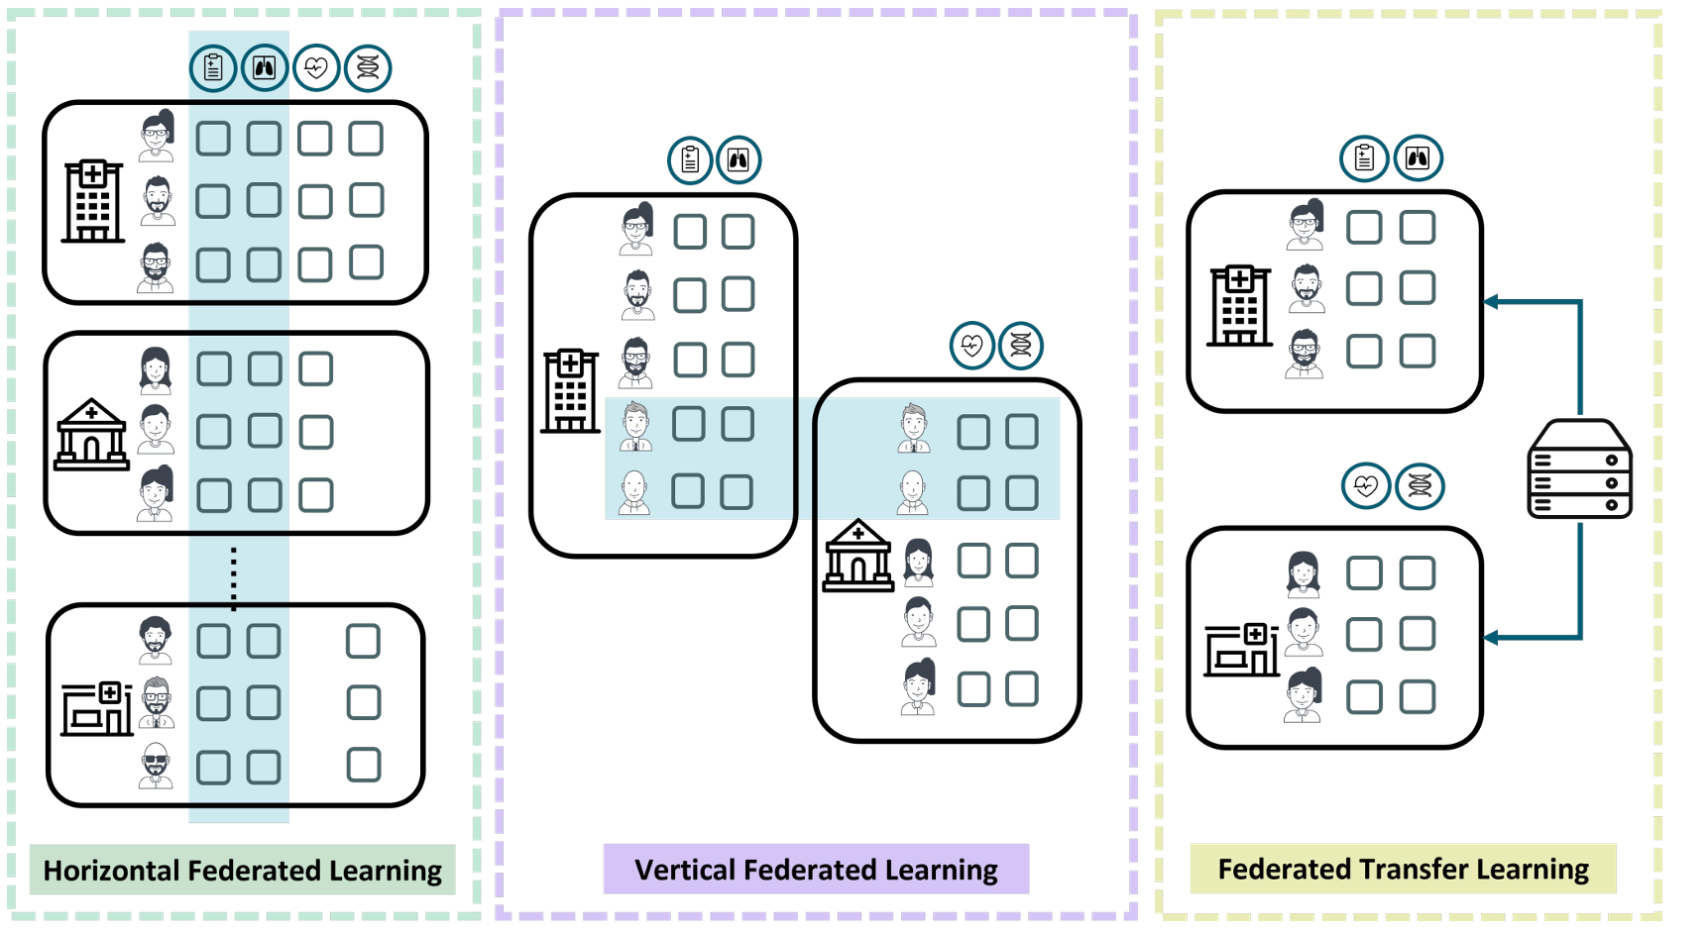
Data distribution strategy
Zhu et al. (2025), Figure 4. CC BY 4.0.
Notes:
Horizontal federation: different patients with comparable features. Vertical federation: overlapping patients with different features, requiring appropriate entity alignment. Federated transfer learning: limited overlap in samples and features, with knowledge transfer across datasets. These are primarily federated learning categories and extend the survey taxonomy in this workshop.
Discussion: Which overlap do we need to agree before choosing an analysis?
Sources:
Zhu, S. Y., Tang, W., Xie, Y. T. and Xie, L. Z. A comprehensive review of federated learning for multi-center medical data. Biomedical Engineering Communications 4(2) (2025):9. DOI: 10.53388/BMEC2025009. CC BY 4.0.
Wang, Z., Ji, H., Zhu, Y., Wang, D. and Han, Z. A Survey on Federated Analytics: Taxonomy, Enabling Techniques, Applications and Open Issues. IEEE Communications Surveys & Tutorials 28 (2026), 2457–2496. Online 10 April 2025. DOI: 10.1109/COMST.2025.3558755.

Slide 20
Iteration pattern
Notes:
Section transition. Briefly locate the highlighted topic within the taxonomy. The survey has five dimensions. Data distribution strategy is the workshop extension based on Zhu et al. Spend around 15 seconds on this roadmap.
Sources:
Wang, Z., Ji, H., Zhu, Y., Wang, D. and Han, Z. A Survey on Federated Analytics: Taxonomy, Enabling Techniques, Applications and Open Issues. IEEE Communications Surveys & Tutorials 28 (2026), 2457–2496. Online 10 April 2025. DOI: 10.1109/COMST.2025.3558755.
Zhu, S. Y., Tang, W., Xie, Y. T. and Xie, L. Z. A comprehensive review of federated learning for multi-center medical data. Biomedical Engineering Communications 4(2) (2025):9. DOI: 10.53388/BMEC2025009. CC BY 4.0.

Slide 21
Iteration pattern
One-shot | Iterative
One round produces the result | Several rounds produce the result
Fixed local computation | Later computation uses earlier results
Example: counts and sums for a mean | Example: progressively finding frequent sequences
Notes:
Teaching notes:
One round contains distribution of a computation, local work, insight upload and aggregation. Repeated rounds may solve dependent subproblems or refine a model until convergence. Iteration does not by itself make a task federated learning. Counts and sums can support a one-shot mean before additional privacy protections. Each further round creates communication, availability and potentially privacy costs.
Discussion prompt (choose according to time):
What would make an analytical task require a second round?
Survey source: III-D3.
Sources:
Wang et al. A Survey on Federated Analytics: Taxonomy, Enabling Techniques, Applications and Open Issues. IEEE Communications Surveys & Tutorials, 28 (2026), 2457–2496. Published online 2025. DOI: 10.1109/COMST.2025.3558755. Local source: Reference papers/a survey on federated analytics.pdf.

Slide 22
One-shot and iterative workflows
Wang et al. (2025), Figure 2.
Notes:
Teaching notes:
The original figure shows local insight extraction and server aggregation on the left. The right-hand side shows repeated computation-model distribution, local computation, insight upload and aggregation. One-shot tasks complete after one round. The locks represent privacy mechanisms in the design, which need explicit assumptions.
Discussion prompt (choose according to time):
Which parts happen at the client and which at the server?
Survey source: III-A, Figure 2.
Sources:
Wang et al. A Survey on Federated Analytics: Taxonomy, Enabling Techniques, Applications and Open Issues. IEEE Communications Surveys & Tutorials, 28 (2026), 2457–2496. Published online 2025. DOI: 10.1109/COMST.2025.3558755. Local source: Reference papers/a survey on federated analytics.pdf.
Use the workflow to explain iteration. One-shot protocols collect one contribution per client for the task. Iterative protocols repeat query, local computation and aggregation, with each round potentially depending on earlier results. The figure illustrates a general workflow rather than claiming that every task needs several rounds. Discussion: What would make a second round necessary?

Slide 23
Coordination model
Notes:
Section transition. Briefly locate the highlighted topic within the taxonomy. The survey has five dimensions. Data distribution strategy is the workshop extension based on Zhu et al. Spend around 15 seconds on this roadmap.
Sources:
Wang, Z., Ji, H., Zhu, Y., Wang, D. and Han, Z. A Survey on Federated Analytics: Taxonomy, Enabling Techniques, Applications and Open Issues. IEEE Communications Surveys & Tutorials 28 (2026), 2457–2496. Online 10 April 2025. DOI: 10.1109/COMST.2025.3558755.
Zhu, S. Y., Tang, W., Xie, Y. T. and Xie, L. Z. A comprehensive review of federated learning for multi-center medical data. Biomedical Engineering Communications 4(2) (2025):9. DOI: 10.53388/BMEC2025009. CC BY 4.0.

Slide 24
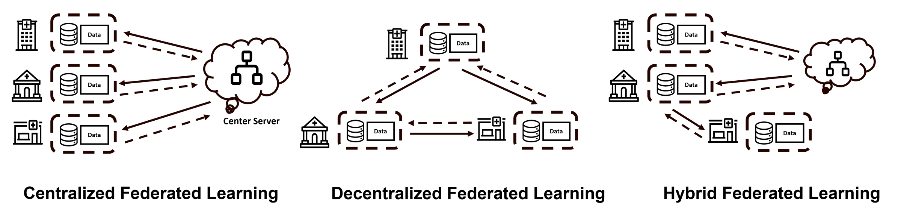
Coordination models
Model | Communication pattern
Server-client | Clients communicate with a central coordinator
Hybrid | Coordinator plus communication between clients
Fully decentralised | Participants coordinate without a central server
Zhu et al. (2025), Figure 3. CC BY 4.0.
Notes:
Server-client corresponds to the centralized coordination shown in the left panel. Decentralized coordination appears in the middle panel. Hybrid coordination appears on the right. The figure depicts federated learning, but illustrates coordination architectures also relevant to federated analytics. A central coordinator does not imply centralized raw records.
Discussion: Who coordinates the task, and which participants communicate directly?
Sources:
Zhu, S. Y., Tang, W., Xie, Y. T. and Xie, L. Z. A comprehensive review of federated learning for multi-center medical data. Biomedical Engineering Communications 4(2) (2025):9. DOI: 10.53388/BMEC2025009. CC BY 4.0.
Wang, Z., Ji, H., Zhu, Y., Wang, D. and Han, Z. A Survey on Federated Analytics: Taxonomy, Enabling Techniques, Applications and Open Issues. IEEE Communications Surveys & Tutorials 28 (2026), 2457–2496. Online 10 April 2025. DOI: 10.1109/COMST.2025.3558755.

Slide 25
Privatization methodology
Notes:
Section transition. Briefly locate the highlighted topic within the taxonomy. The survey has five dimensions. Data distribution strategy is the workshop extension based on Zhu et al. Spend around 15 seconds on this roadmap.
Sources:
Wang, Z., Ji, H., Zhu, Y., Wang, D. and Han, Z. A Survey on Federated Analytics: Taxonomy, Enabling Techniques, Applications and Open Issues. IEEE Communications Surveys & Tutorials 28 (2026), 2457–2496. Online 10 April 2025. DOI: 10.1109/COMST.2025.3558755.
Zhu, S. Y., Tang, W., Xie, Y. T. and Xie, L. Z. A comprehensive review of federated learning for multi-center medical data. Biomedical Engineering Communications 4(2) (2025):9. DOI: 10.53388/BMEC2025009. CC BY 4.0.

Slide 26
Privatization methodology
Protection can act at different points in a federated analysis.
Protection point | Purpose | Approaches
Raw records | Reduce direct exposure of underlying data | Keep raw data with their owners
Shared contributions | Limit what others learn from each client’s output | Cryptographic protection or local differential privacy
Released results | Limit disclosure through records or statistics | k-anonymity, release thresholds or differential privacy
Keeping records local is the starting point. Contributions and released results also need protection.
Notes:
Suggested time: 2 minutes. These protection points are complementary and do not form a ranking from weak to strong. Cryptography protects contributions during communication or joint computation. It does not automatically make the final result safe. Differential privacy bounds disclosure through randomisation under a defined neighbouring-data relation and privacy budget. Classic k-anonymity applies to released records whose quasi-identifiers match in groups of at least k. The survey also discusses releasing items supported by at least k clients. Such thresholds are a different condition, and do not provide the same guarantee as classic k-anonymity or differential privacy. Raw retention alone offers no formal guarantee against information revealed by outputs.
Discussion: Which information could still be revealed after records remain local? Example for discussion: a mean for a group of one reveals that individual value. Source: survey III-D5 and V.
Sources:
Wang, Z., Ji, H., Zhu, Y., Wang, D. and Han, Z. A Survey on Federated Analytics: Taxonomy, Enabling Techniques, Applications and Open Issues. IEEE Communications Surveys & Tutorials 28 (2026), 2457–2496. Online 10 April 2025. DOI: 10.1109/COMST.2025.3558755.

Slide 27
Local, central and distributed DP
Differential privacy bounds disclosure about a protected contribution.
Approach | Where protection happens | Trust assumption
Local DP | Each client randomises its contribution before sharing | The client protects its contribution before the server receives it
Central DP | A trusted curator protects the released result | The curator can access unprotected inputs or contributions
Distributed DP | Distributed randomisation with secure computation | Protection depends on the protocol and collusion assumptions
The distinction is where protection happens and whom the protocol requires us to trust.
Notes:
Suggested time: 2 minutes. DP is a formal property of a randomised mechanism. Define the protected unit, for example a person, a record or an organisation, and the neighbouring-data relation. Central DP can permit more accurate results for a given target guarantee but requires trust in the curator. Local DP protects before sharing, often with a greater accuracy cost. Distributed DP uses collective randomisation and secure computation to obtain a central-style guarantee under explicit protocol, dropout and collusion assumptions. Distributed DP is not guaranteed merely because clients compute locally. Repeated releases consume a cumulative privacy budget. Avoid a detailed cryptographic example here.
Discussion: Which party can see the unprotected contributions in each model? Source: survey III-D5, V and XI-D.
Sources:
Wang, Z., Ji, H., Zhu, Y., Wang, D. and Han, Z. A Survey on Federated Analytics: Taxonomy, Enabling Techniques, Applications and Open Issues. IEEE Communications Surveys & Tutorials 28 (2026), 2457–2496. Online 10 April 2025. DOI: 10.1109/COMST.2025.3558755.

Slide 28
Accuracy, privacy and performance
Approach | Possible consequence
Release thresholds | Some results are unavailable, especially for rare groups
Differential privacy | Randomisation can introduce additional error
Cryptographic protection | Computation and communication can cost more
Notes:
Suggested time: 1 minute. These are possible costs, not an inevitable ranking of approaches. Error and workload depend on data volume, the mechanism, number of queries, network architecture and implementation. Sampling and sketches introduce additional accuracy and resource trade-offs, covered next.
Discussion: Which results must remain available, and how much error is acceptable? Source: survey V and XI.
Sources:
Wang, Z., Ji, H., Zhu, Y., Wang, D. and Han, Z. A Survey on Federated Analytics: Taxonomy, Enabling Techniques, Applications and Open Issues. IEEE Communications Surveys & Tutorials 28 (2026), 2457–2496. Online 10 April 2025. DOI: 10.1109/COMST.2025.3558755.

Slide 29
Enabling techniques
Technique | Role in federated analytics
Sketching and data structures | Compact summaries or structures support efficient aggregation
Sampling | Fewer observations or clients reduce work
Optimisation | Allocate computation, communication and privacy budgets
Game theory and incentives | Support participation and cooperation
Notes:
Suggested time: 2 minutes. Sketches are compact summaries for approximate tasks, including cardinality and frequency estimation. Mergeable structures allow combining local summaries. Trie and summation tree structures support specific frequency and aggregation tasks. Sampling can lower workload. Privacy amplification by sampling depends on a valid sampling scheme and its assumptions, and should not be claimed for arbitrary selection. Optimisation balances resources, accuracy and privacy. Incentive and game-theoretic methods address strategic behaviour, participation and fairness.
Discussion: Which technique addresses a computational limit, and which addresses a participation limit? Source: survey V-A to V-E.
Sources:
Wang, Z., Ji, H., Zhu, Y., Wang, D. and Han, Z. A Survey on Federated Analytics: Taxonomy, Enabling Techniques, Applications and Open Issues. IEEE Communications Surveys & Tutorials 28 (2026), 2457–2496. Online 10 April 2025. DOI: 10.1109/COMST.2025.3558755.

Slide 30
Key challenges
Challenge | Why it matters
Diverse analytical tasks | Different insight and aggregation designs
Intensive computation | Protection can exceed local capacity
Wireless communication | Slow or unavailable clients delay completion
Limited privacy resources | Repeated releases require budget accounting
Data heterogeneity | Participants hold different distributions
Notes:
Teaching notes:
Section IV lists six challenges: task diversity, the accuracy/privacy/performance trade-off, intensive computation, wireless communication, limited privacy resource and data heterogeneity. The preceding slide covers the trade-off. Slow participants create a straggler effect. Privacy costs need explicit composition accounting when DP applies. Participation failures can affect both performance and the population represented.
Discussion prompt (choose according to time):
What could change if the slowest participants are systematically different from the fastest?
Survey source: IV-A–IV-F.
Sources:
Wang et al. A Survey on Federated Analytics: Taxonomy, Enabling Techniques, Applications and Open Issues. IEEE Communications Surveys & Tutorials, 28 (2026), 2457–2496. Published online 2025. DOI: 10.1109/COMST.2025.3558755. Local source: Reference papers/a survey on federated analytics.pdf.

Slide 31
Open research issues
Research direction | Questions that remain open
Broader analytics | Complex data scenarios and a unified framework for FA
Privacy guarantees | Privacy at scale and comparable formal privacy measures
Efficient systems | System efficiency, wireless aggregation and resource management
Notes:
Suggested time: 2 minutes. This slide groups the seven open issues in section XI. A: more complex data analytics scenarios. B: a unified framework for FA. C: privacy at scale. D: formal privacy measurement and comparison. E: system-efficient FA. F: wireless communication for FA, including over-the-air computation. G: resource management. The grouping is a teaching summary rather than a new taxonomy.
Discussion: Which issue is most likely to limit a real deployment? Source: survey XI-A to XI-G.
Sources:
Wang, Z., Ji, H., Zhu, Y., Wang, D. and Han, Z. A Survey on Federated Analytics: Taxonomy, Enabling Techniques, Applications and Open Issues. IEEE Communications Surveys & Tutorials 28 (2026), 2457–2496. Online 10 April 2025. DOI: 10.1109/COMST.2025.3558755.

Slide 32
Key principles
The analytical task determines the local insights and aggregation.
Local data retention needs additional protection for shared outputs.
Accuracy and system costs depend on the full protocol.
Notes:
Suggested time: 2 minutes including discussion. Recap the distinction between a statistical target and a distributed protocol. Identify which data and outputs require protection, then specify architecture, trust and acceptable error. These are general principles before introducing the outbreak clinical characterisation context in session 2.
Closing discussion: For one analytical task, what would each client compute, what would be combined, and what could the output disclose?
Sources:
Wang, Z., Ji, H., Zhu, Y., Wang, D. and Han, Z. A Survey on Federated Analytics: Taxonomy, Enabling Techniques, Applications and Open Issues. IEEE Communications Surveys & Tutorials 28 (2026), 2457–2496. Online 10 April 2025. DOI: 10.1109/COMST.2025.3558755.

Slide 33
References
Wang, Z., Ji, H., Zhu, Y., Wang, D. and Han, Z.
A Survey on Federated Analytics: Taxonomy, Enabling Techniques, Applications and Open Issues.
IEEE Communications Surveys & Tutorials 28 (2026), 2457–2496. Online 2025. DOI: 10.1109/COMST.2025.3558755
Zhu, S. Y., Tang, W., Xie, Y. T. and Xie, L. Z.
A comprehensive review of federated learning for multi-center medical data.
Biomedical Engineering Communications 4(2) (2025):9. DOI: 10.53388/BMEC2025009
Notes:
The FA survey is the main source for this session. The medical review provides Figures 3 and 4 and the additional data distribution dimension. Zhu et al. figures are reproduced under CC BY 4.0.
Sources:
Wang, Z., Ji, H., Zhu, Y., Wang, D. and Han, Z. A Survey on Federated Analytics: Taxonomy, Enabling Techniques, Applications and Open Issues. IEEE Communications Surveys & Tutorials 28 (2026), 2457–2496. Online 10 April 2025. DOI: 10.1109/COMST.2025.3558755.
Zhu, S. Y., Tang, W., Xie, Y. T. and Xie, L. Z. A comprehensive review of federated learning for multi-center medical data. Biomedical Engineering Communications 4(2) (2025):9. DOI: 10.53388/BMEC2025009. CC BY 4.0.

